Slide 1
WHAT IS NEUROSCIENCE?
Neuroscientists are interested in what the building blocks of the brain are, and how these components interact with the environment and with each other to produce thoughts, feelings and behaviors.
Notes:
In short: neuroscientists want to understand how the brain works. We all have one, and in some ways are quite familiar with it… and yet, it is one of the most complex objects in the known universe.
There is a lot we would like to understand about it. What does it mean to understand the brain? Fix it when broken or enhance its function/make it more resilient; predict how it will respond; satisfy our own curiosity of how our own behavior and experience and those of others can arise out of electrical activity patterns in a network of cells.

Slide 2
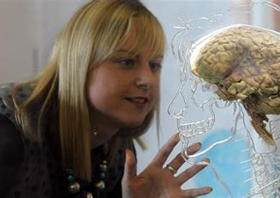
WHAT IS THE MAJOR IN NEUROSCIENCE LIKE?
The major in Neuroscience includes courses in
Cellular and Molecular Neuroscience (with lab)
Systems Neuroscience (with lab)
Behavioral Neuroscience
Social Neuroscience
Cognitive Neuroscience
Computational Neuroscience
Neural basis of stress, reward, addiction, memory, …
Students have the opportunity to engage in research with faculty members (typically starting in sophomore year, but potentially earlier through e.g. the Women In Science Program).
Notes:
There are many different ways of studying the brain. One is to think about different scales, starting with small things (molecules, cells) to larger things (systems, interacting cells) and then whole organisms.

Slide 3
WHAT CAN I DO WITH A NEUROSCIENCE MAJOR?
Many Dartmouth Neuroscience majors go on to health-related careers (medical school, clinical research, global health)
Dartmouth Neuroscience alumni also go on to a wide range of other careers, including law, business, marketing, consumer devices, data science, consulting, counseling, and public service
Notes:
rigorous but also interdisciplinary – neuroscientists are adept at using concepts, tools from many different areas, they are versatile and adaptable.

Slide 4
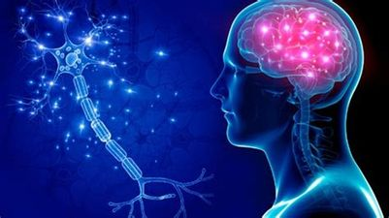
WHERE DO I BEGIN MY STUDY?
With PSYC 6 (Introduction to Neuroscience)
“What are the basic structural and functional units of the nervous system, and how do they produce sensation, action, motivation, emotion and cognition?”
Lecture-based course with discussion components
Offered this Fall (11 time slot) and Winter

Slide 5
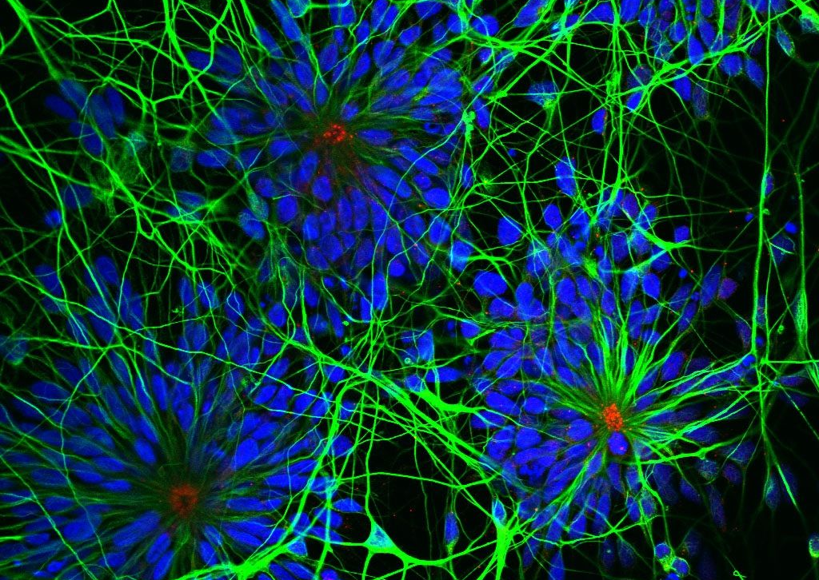
WHAT’S NEXT AFTER PSYC 6?
Our next level of “core” courses are numbered in the 30s and are surveys of sub-areas within the discipline (Cellular/Molecular, Systems, Behavioral, Cognitive Neuroscience).
If you are interested in a pre-health track, check out the Dartmouth Health Professions Program checklist for what other courses to take.

Slide 7
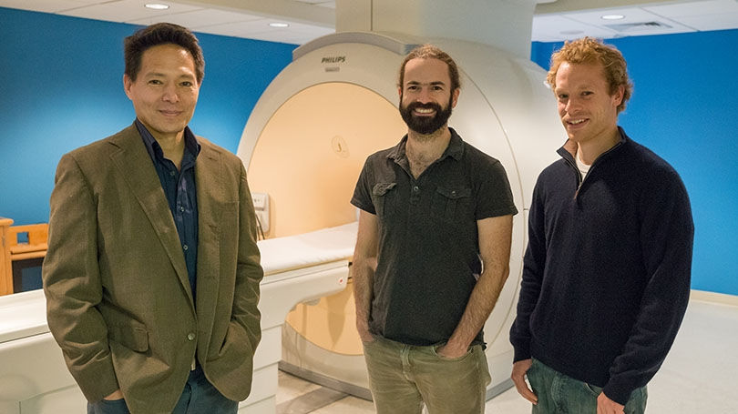

Slide 8
Should I take Intro to Neuroscience (PSYC 6) or Intro to Psychology (PSYC 1)?
PSYC 1 and PSYC 6 are different courses with different content.
PSYC 1 is prerequisite to the Psychology major. PSYC 6 is prerequisite to the Neuroscience major.
Some upper-level courses accept either course as a prerequisite. Others accept only one or the other – take a look which are most interesting to you on the departmental website (pbs.Dartmouth.edu)
Many students eventually take both courses.

Slide 9
We look forward to seeing you in our classes!

